Slide 1
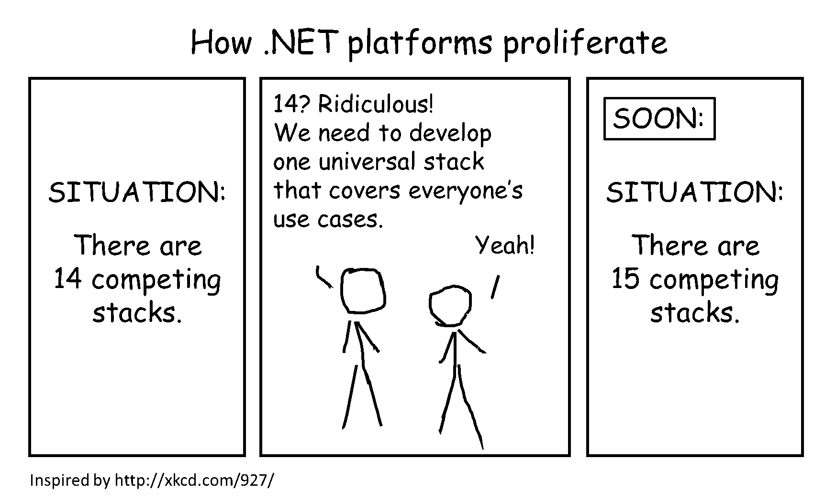
.NET Core or .NET Framework: Which one should I choose?
Kwen Peterson, Senior Software Developer @ Raven Email: kwen.peterson@gmail.com Twitter: @kwenarik

Slide 2


Slide 3
https://github.com/Kwen/sdcodecamp16
“You’re already in the top tier of developers just by showing up here tonight. I don’t know how talented you are, how much experience you have, but you showed up. You’re putting yourself out there because you care to improve. Thanks for caring.” –Scott Hanselman

Slide 4





Slide 5
Why .NET?
Devs can target a single common set of libraries that are supported by multiple platforms (Linux, OS X)
Devs can build applications for any platform from any platform.
Smaller, more minimal libraries means a smaller overall footprint.
Upgrades have a smaller impact, since only the packages you are using are affected.
Smaller footprint makes Core up to 10x faster, but not all .NET Framework functionality exists in .NET Core yet.

Slide 6
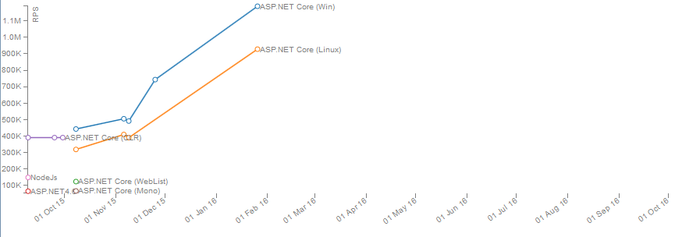
http://web.ageofascent.com/asp-net-core-exeeds-1-15-million-requests-12-6-gbps/

Slide 7




Slide 8
How do I get .net core?
(on windows)
For Visual Studio development
Install Visual Studio 2015 Update 3
Install .NET Core 1.0.1 – VS 2015 Tooling Preview 2
For command-line development (or using VS Code or other editor of your choice)
Install the .NET Core SDK for Windows
Install NPM
npm install –g bower
npm install -g gulp
For other operating systems (Mac, Docker, Linux)
Go to https://www.microsoft.com/net/core and follow the instructions

Slide 9
CLI DEMO

Slide 10
Donet CLI
dotnet new
dotnet restore
dotnet build -r win10-x64
dotnet build -r osx.10.10-x64
dotnet build -r ubuntu.14.04-x64
dotnet run
dotnet publish –c release –r win10-x64
dotnet publish –c release –r osx.10.10-x64
dotnet publish –c release –r Ubuntu.14.04-x64

Slide 11
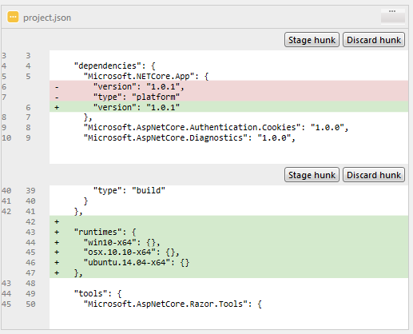
Platform & runtimes

Slide 12
https://docs.microsoft.com/en-us/dotnet/articles/core/rid-catalog
Windows | Win7-x64 | Win7-x86 | Win8-x64 | Win8-x86 | Win8-arm | Win81-x64 | Win81-x86 | Win81-arm | Win10-x64 | Win10-x86 | Win10-arm | Win10-arm64
OS X | Osx.10.10-x64 | Osx.10.11-x64 | Osx.10.12-x64
Linux | Rhel.7.0-x64 | Rhel.7.1-x64 | Rhel.7.2-x64 |  | Ubuntu.14.04-x64 | Ubuntu.14.10-x64 | Ubuntu.15.04-x64 | Ubuntu.15.10-x64 | Ubuntu.16.04-x64 | Ubuntu.16.10-x64 | Debian.8-x64 | Centos.7-x64
Linux | Fedora.23-x64 | Fedora.24-x64

Slide 13
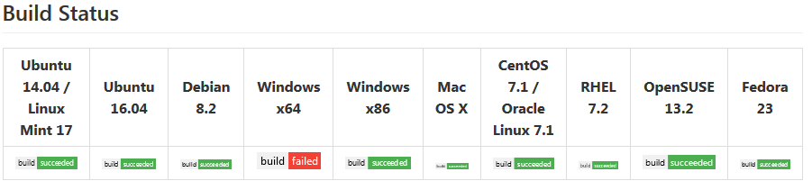
Current build status (from 11/4)
https://github.com/dotnet/cli/#rtm-and-preview-2-bits

Slide 14
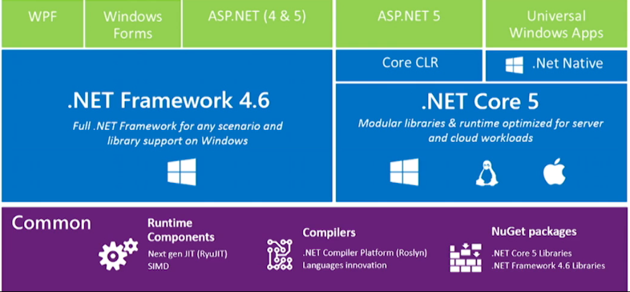
Notes:
.NET Framework 4.6 is a full framework for everything related to .NET, but lacks libraries & runtime optimized for multi-platform (Windows, Linux and Mac) and cloud deployments
.NET Core on the other hand is a subset of .NET Framework 4.6 which is mainly optimized for multi-platform and cloud deployments
.NET Native is mainly used to develop Universal Apps which will be quite optimized to run on any device and platform, natively (not for the web apps though)
An interesting point is ASP.NET:
If we need backward compatibility to the fullest extent (say web forms or aspx support), we need to go with .NET Framework 4.6
If we develop MVC, Web API or Razor web pages, then we can deploy those web apps either in .NET Framework 4.6 or .NET Core environment

Slide 15
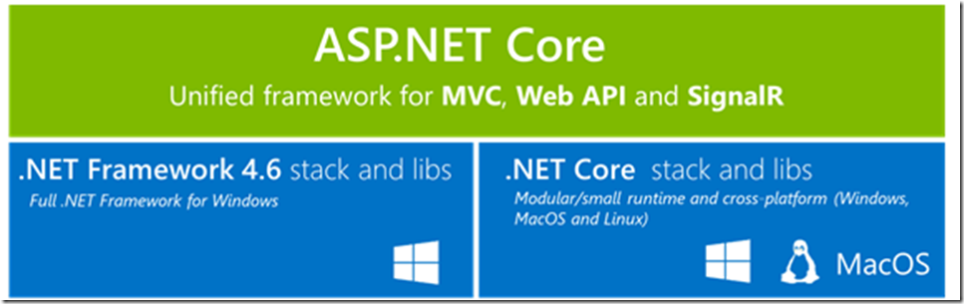
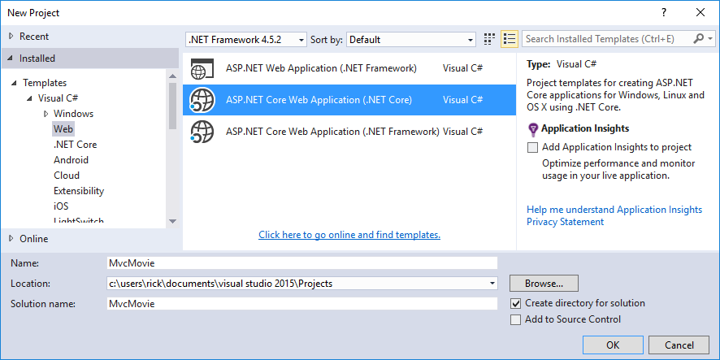
ASP.NET Core

Slide 16
DEMO
Notes:
dotnet new –t web
dotnet restore
dotnet run

Slide 17

kestrel
Hosting a website by running a console app
Basically Microsoft’s version of Apache
Much smaller (& faster) footprint than IIS
Allows you to have ASP.NET projects that are basically just console apps.
Not hardened like IIS is…don’t use it to host exposed websites quite yet!
Open source, which gives us this…
Notes:
Ben Adams doesn’t even work for Microsoft. He works for Illyriad Games.

Slide 18
ASP.NET Core Highlights
System.Web.MVC.Controller & System.Web.Http.ApiController are gone. They have both been merged into the base "Controller" class now.
wwwroot directory in project is for static content like css, Js, images. And it’s the default root of your server. If a request comes in for a static file on disk, if the file is in this folder then it can go directly back to client.
Web.config and Global.asax are gone. Web.config is replaced with appsettings.json and Global.asax is now Startup.cs.
Unlike the packages.config file, typing a new package (with Intellisense!) into the project.json file will automatically add the reference for you and pull down the Nuget package.
IServiceProvider, built-in native container for dependency injection
Tag Helpers > HTML Helpers
Support for bower and npm package managers have been added…because why not try to simultaneously use 3 package managers! (Nuget is for "compiled binaries" now, bower/npm are for front-end, uncompiled stuff.)
Notes:
Talk about middleware, environment variable

Slide 19
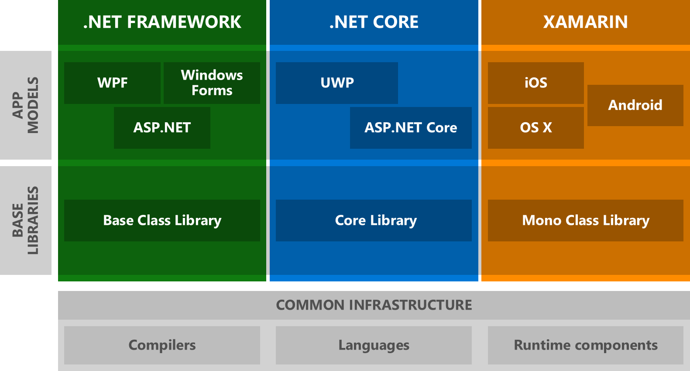
This is currently what we have…
Notes:
There are currently three major flavors of .NET, which means you have to master three different base class libraries in order to write code that works across all of them. Since the industry is much more diverse now than when .NET was originally created it’s safe to assume that we’re not done with creating new .NET platforms. Either Microsoft or someone else will build new flavors of .NET in order to support new operating systems or to tailor it for specific device capabilities…like HoloLens.

Slide 20
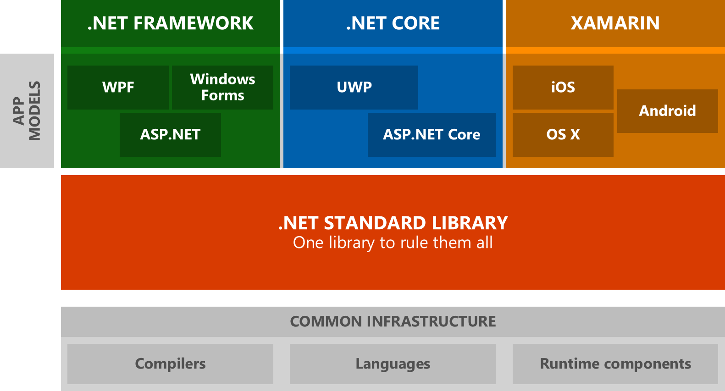
…This is the future.
.NET Standard
Notes:
This is where the .NET Standard comes in. For developers, this means we only have to master one base class library. Libraries targeting .NET Standard will be able to run on all .NET platforms and platform providers don’t have to guess which APIs they need to offer in order to consume the libraries available on NuGet.

Slide 21
What is .NET standard?
.NET Standard is a set of APIs that all .NET platforms have to implement. This unifies the .NET platforms and prevents future fragmentation.
.NET Standard 2.0 will be implemented by .NET Framework, .NET Core, and Xamarin. For .NET Core, this will add many of the existing APIs that have been requested.
.NET Standard 2.0 includes a compatibility shim for .NET Framework binaries, significantly increasing the set of libraries that you can reference from your .NET Standard libraries.
.NET Standard will replace Portable Class Libraries (PCLs) as the tooling story for building multi-platform .NET libraries.
As we saw with the targetable runtimes earlier.
The goal of all of this is to take the same code, change your project references and using statements, and have all your base methods work, providing the exact same functionality with the same parameter input.
Should be ready to ships with Visual Studio “15” (Spring 2017?)

Slide 22
.NET Standard
https://blogs.msdn.microsoft.com/dotnet/2016/09/26/introducing-net-standard/
.NET Platform | Standard 1.0 | 1.1 | 1.2 | 1.3 | 1.4 | 1.5 | 1.6 | 2.0
.NET Core | 1.0 | 1.0 | 1.0 | 1.0 | 1.0 | 1.0 | 1.0 | 1.2*
.Net Framework | 4.5 | 4.5 | 4.5.1 | 4.6 | 4.6.1 | 4.6.2 | vNext | 4.6.1
Xamarin.iOS | vNext | vNext | vNext | vNext | vNext | vNext | vNext | vNext
Xamarin.Android | vNext | vNext | vNext | vNext | vNext | vNext | vNext | vNext
Universal Windows Platform | 10.0 | 10.0 | 10.0 | 10.0 | 10.0 | vNext | vNext | vNext
Windows | 8.0 | 8.0 | 8.1
Windows Phone | 8.1 | 8.1 | 8.1
Windows Phone Silverlight | 8.0

Slide 23
Timeline
October 25, 2016 - .Net Core 1.1 Preview 1
1380 new APIs
https://github.com/dotnet/core/blob/master/release-notes/1.1/1.0-1.1-api-diff/1.0-1.1-api-diff.md
Bug fixes
Spring 2017 - .Net Core 1.2
WebSockets
SignalR
Razor Pages
Web API security
Full Standard 2.0 support…supposedly

Slide 24









Slide 25
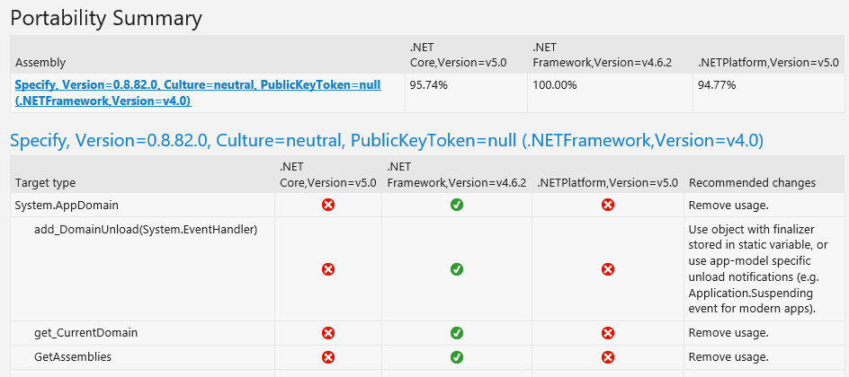
Migrate existing Framework to core (1)
Console App / Visual Studio plugin
.Net Portability Analyzer

Slide 26
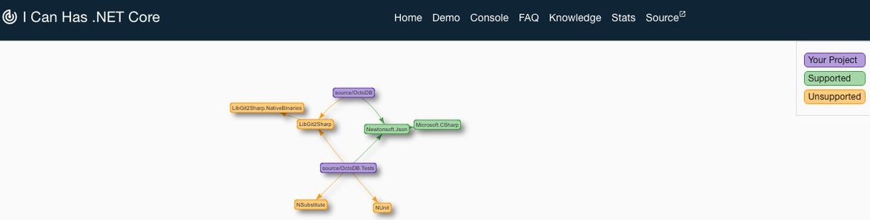
Migrate Existing Framework to core (2)
Website
I Can Has .NET Core
Upload packages.config, project.json, paket.dependencies files for analysis and it will build a visualization of the packages and whether .NET Standard versions are available on nuget.org.

Slide 27
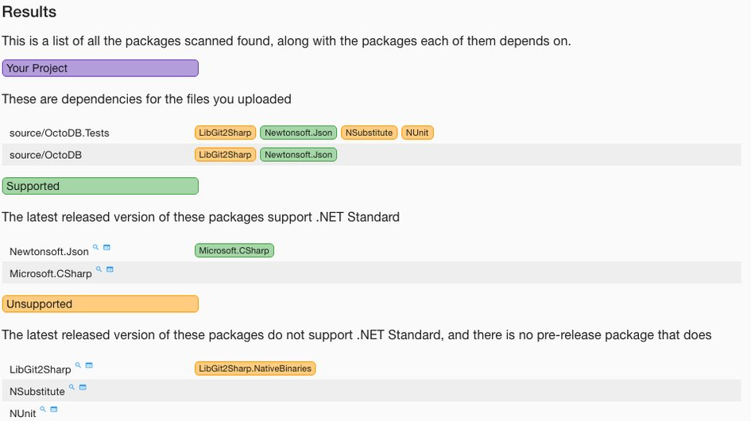
Migrate Existing Framework to core (3)
WEBSITE

Slide 28
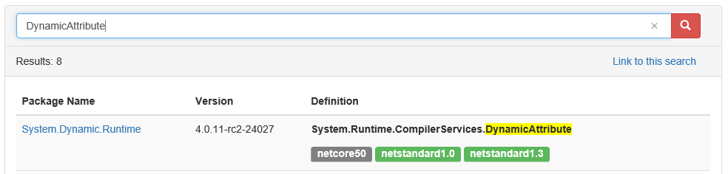
Migrate Existing Framework to core (4)
WEBSITE
Reverse Package Search

Slide 29
COMPILER DIRECTIVES (5)
System.Type vs. System.Reflection extension methods / Polyfills
#if NET40 public static class TypeExtensions { public static Assembly Assembly(this Type type) { return type.Assembly; }
public static bool IsValueType(this Type type) { return type.IsValueType; } } #else using System.Linq; public static class TypeExtensions { public static Assembly Assembly(this Type type) { return type.GetTypeInfo().Assembly; }
public static bool IsValueType(this Type type) { return type.GetTypeInfo().IsValueType; } } #endif

Slide 30
Microsoft committed to an api versioning pattern!
Microsoft’s official stance:
Embedded in the path of the request URL, at the end of the service root:
https://api.contoso.com/v1.0/products/users
As a query string parameter of the URL:
https://api.contoso.com/products/users?api-version=1.0
Read more about it here:
https://github.com/Microsoft/api-guidelines/blob/master/Guidelines.md#12-versioning
https://github.com/Microsoft/aspnet-api-versioning/tree/master/src/Microsoft.AspNetCore.Mvc.Versioning

Slide 31

Questions?
(Yes, that’s a ninja cat riding a T-rex with hand grabbers)
Slides & Demo Code: https://github.com/Kwen/sdcodecamp16

Slide 32
Resources
Using yeoman to create ASP.NET templates
Your first ASP.NET Core Application on a MAC using VS Code
Getting started with ASP.NET Core MVC and Visual Studio
https://blogs.msdn.microsoft.com/dotnet/2016/09/26/introducing-net-standard/
http://stackoverflow.com/questions/29609993/difference-between-net-framework-4-6-net-native-and-net-core
https://blogs.msdn.microsoft.com/dotnet/2016/09/26/introducing-net-standard/
https://github.com/dotnet/cli/#rtm-and-preview-2-bits
https://www.excella.com/insights/demystifying-key-differences-in-net-core-1-0-vs-net-framework
http://www.michael-whelan.net/porting-dotnet-framework-library-to-dotnet-core/
https://visualstudiomagazine.com/articles/2016/09/27/dotnet-standard-2-plans.aspx

